Slide 1
Social Data Institute
Continuing Professional Development (CPD) course
Introduction To Bayesian Inference & Modelling (2022/23)
Day 4: Bayesian SPATIAL RISK MODELLING IN STAN
Dr Anwar Musah (a.musah@ucl.ac.uk)
Lecturer in Social and Geographic Data Science
UCL Geography
Additional details:
https://www.ucl.ac.uk/social-data
1

Slide 2
Social Data Institute
Contents
Problem
Hierarchical models and recap
Types of spatial risk estimation
Odds ratios (ORs)
Relative risk ratios (RRs)
Exceedance Probabilities
Spatial intrinsic conditional autoregressive models (iCARs):
Besag-York-Mollie (within an iCAR framework)
Structured and Unstructured Random Effects
Model formulation from a Bayesian Framework
Examples and interpretation (using Stan)
Knowledge
Collect
Model
Wrangle
Explore
2

Slide 3
Quick recap on hierarchical regression models
3

Slide 4
Social Data Institute
Definition:
A hierarchical regression model, are a specialised group of regression-based models that are able to recognise the existence of hierarchies within a data structure and account for them. It is a statistical model used for exploring the relationship between a dependent variable with one or more independent variables while accounting for these hierarchical structures.
Why are hierarchical regression models important:
It is an elegant way to model datasets that have varying scales in their measurements ( - this artefact is caused by the multilevel or hierarchical structure in the dataset)
It is an robust approach for accounting for variations across individual units, and at the same time, the “within-group variations” among groupings
When we are modelling the direct relationship between the level-1 independent variables against the dependent variable, we can allow for direct interactions between level-1 and higher level independent variables that were measured at a group-level
We can quantify group-specific differences as well as group-specific coefficients through the usage of “varying-slopes” or “varying-coefficients”
4

Slide 5
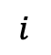
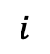


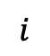
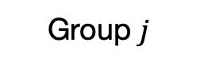
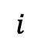

We are Illustrating concisely what we mean by two- or three-level model structure [1]
Group information (level-2)
Group 1
Group 2
Group 3
Group $j$
$$⋯$$
1
2
3
$$⋯$$
$$i$$
1
2
3
$$⋯$$
$$i$$
1
2
3
$$⋯$$
$$i$$
1
2
3
$$⋯$$
$$i$$
Individual information (level-1)
Notes: We have individual units of information that are nested or grouped within a higher measure. This is typically a two-level structure and a two-level hierarchical regression model must be used for this scenario.
5

Slide 6
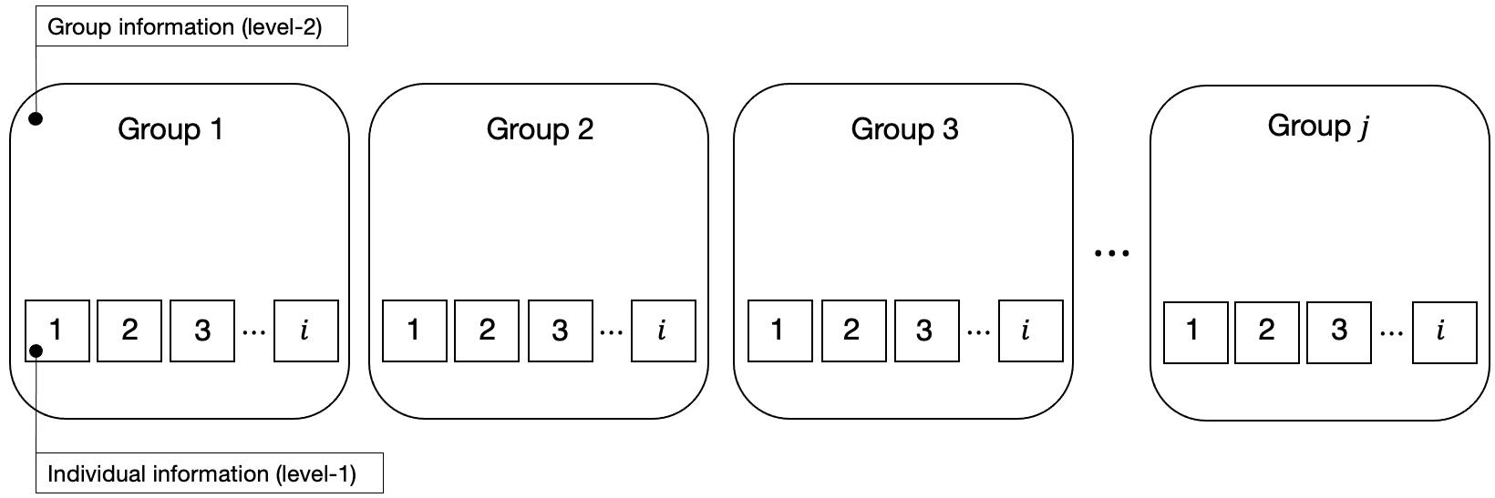


We are Illustrating concisely what we mean by two- or three-level model structure [2]
Higher group information (level-3)
Higher group 1
Higher group 2
Higher group $h$
$$⋯$$
Notes: We have individual units of information that are nested or grouped within a higher measure, where by the same individuals (from the same units) are repeated (i.e., longitudinal). This is typically a three-level structure and so a three-level hierarchical regression model must be used for this scenario.
6
Notes:
Illustrate what these hierarchies are – and then go into why they are important in next slide

Slide 7
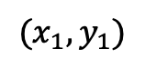
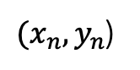
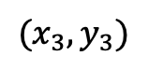
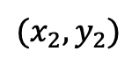
Situating hierarchical models within a spatial context:
Hierarchical models are in fact commonly used in the quantification of certain parameters when dealing spatial and spatiotemporal areal data.
These are statistical model written in mind to deal with multiple hierarchies formed by geographies to estimate parameters of the posterior distribution
Example: Intestinal parasitaemia among school children in Tanzania and infection status linked with anaemia, here students (level-1) are clustered in schools, and the point location serves as the highest hierarchy (level-2).
Health student =
Diseased student =
…
School 1
School 2
School 3
School n
Point locations:
$${(x}_{1},y_{1})$$
$${(x}_{2},y_{2})$$
$$(x_{3},y_{3})$$
$(x_{n},y_{n}$)
7
Notes:
Bayesian inference with a

Slide 8
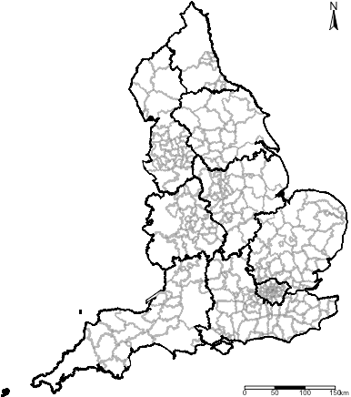
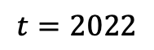
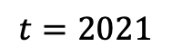
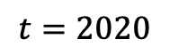
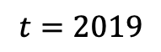
Level 2:
$$t=2019$$
$$t=2020$$
$$t=2021$$
$$t=2022$$
Level 1:
These models allow completely flexibility in the estimation of risks - allowing the user to account for space-time interactions
You can make the model (in contrast to frequentist) to borrow strength across space-time, in order to improve estimation and prediction of an underlying model’s feature
8

Slide 9
Type of spatial risk estimation
9

Slide 10
Social Data Institute
Areal data
Areal, or lattice data arise when dealing with a fixed domain that is partitioned to a finite number of sub-regions at which outcome can be aggregated too
Examples of areal data are:
Number of cancer cases in counties
Number of road accidents in districts
Proportion of people living in poverty in postcode block etc.
Often, risk models aim to obtain such estimates within such areas where data is available. We can use Bayesian Hierarchical Models in this context, depending on the type of study design, to estimate the following: Odds Ratios (ORs) or Relative Risk (RRs)
10
Notes:
Bayesian inference with a

Slide 11
Social Data Institute
Interpretation of Risk Ratios (RR)
RR= 1 (null value), it means that independent variable has no effect on the outcome
RR < 1, the independent variable has an impact on the outcome – in this case, its reduced effect, or reduced risk on the outcome
RR > 1, the independent variable has an impact on the outcome – and so, in this case, its increased effect, or increased risk on the outcome
From hazards models:
Cox Proportional Hazards model
Any Poisson model
11

Slide 12
Social Data Institute
Interpretation of Odds Ratios (OR)
OR = 1 (null value), it means that independent variable has no effect on the outcome
OR < 1, the independent variable has an impact on the outcome – in this case, its reduced effect, or reduced risk on the outcome
OR > 1, the independent variable has an impact on the outcome – and so, in this case, its increased effect, or increased risk on the outcome
From models:
Binary or Binomial regression model
12

Slide 13
Social Data Institute
Exceedance Probability
Exceedance Probabilities (or Marginals) is a statistical measure describing the probability that an estimated risk value for an areal-unit exceeds a given threshold.
A common example used in every day application are disease risk models, we are usually concerned about areas that have excess risk of a disease type i.e., P(RR > 1.00) or P(OR > 1.00)
In epidemiology, the Exceedance Probabilities have been operationalised to detect clusters of areas with exceedingly higher risk of a disease (or adverse event).
13

Slide 14
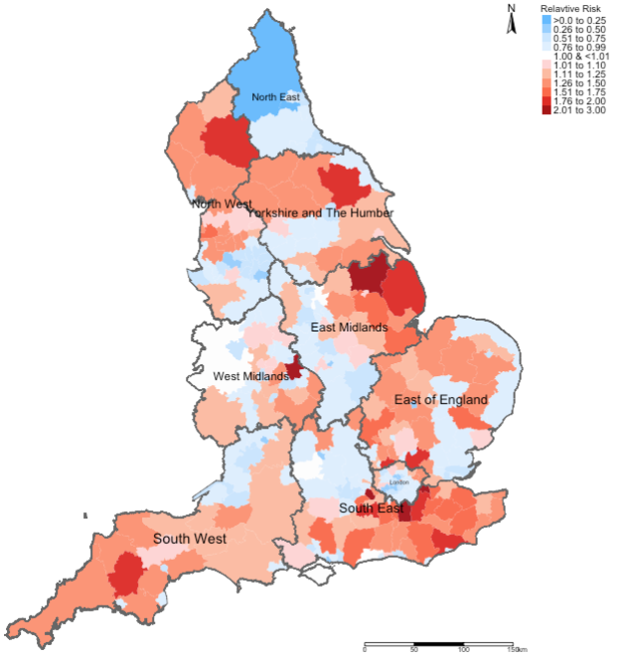
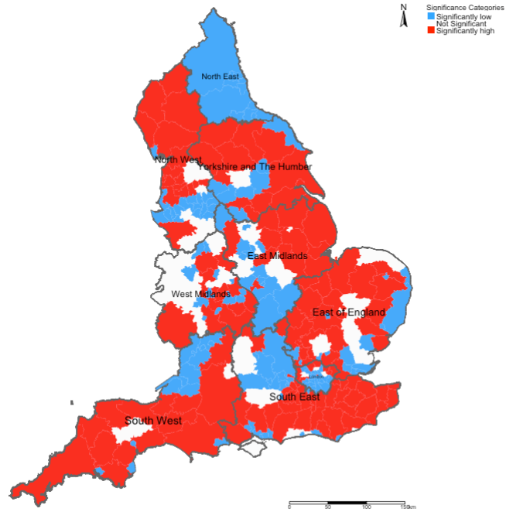
Example: Risks of Road-related casualties in England 2015-2020 [1]
Relative Risks (RR)
Overall significance (95% Credibility Intervals)
14

Slide 15
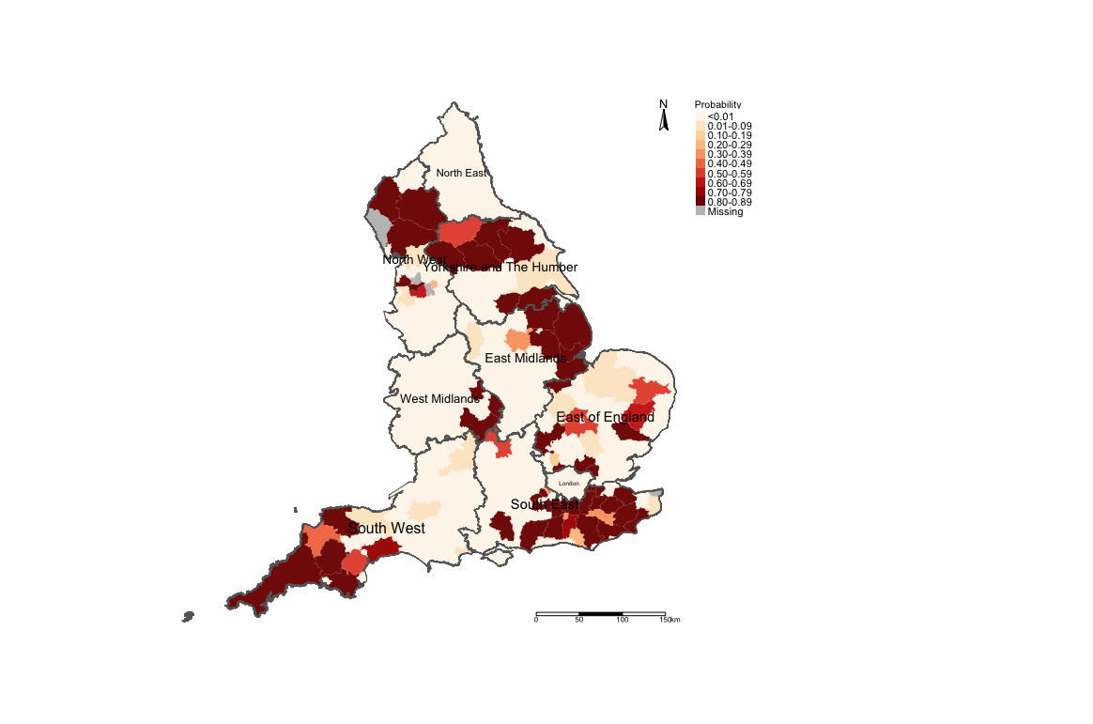
Example: Risks of Road-related casualties in England 2015-2020 [2]
The areas in darker reds are perhaps priority areas for some road safety policy should be implemented?
Exceedance Probability i.e., P(RR > 1.40) (i.e., risk are 40% higher than expected)
15

Slide 16
Spatial Intrinsic Conditional Autoregressive models (ICARs)
16

Slide 17
Social Data Institute
Besag-York-Mollie (BYM) model
This is a popular spatial model which takes into account that the data may potentially be spatially correlated and the observations in the neighbouring areas may be more similar than observations in areas that are distant from each other.
This is a type of hierarchical model which includes a spatial random effect,
It is heavy dependent on neighbourhood adjacency matrix
There are two versions of this model:
BYM model that has a spatial effect term only that’s treated a smoothing term (multiplied by an error term): Conditional Autoregressive Model (CAR)
BYM model that has both a spatial effect term which is treated a structured random effect, and the error term is an unstructured noise: Intrinisic Conditional Autoregressive Model (iICAR)
When fitting data to this type of model – the best choice of the likelihood function (i.e., statistical model) is Poisson (i.e., aggregated counts to areas). where you have counts and denominators that represent the reference population.
17
Notes:
iCAR model
Counts and reference population

Slide 18
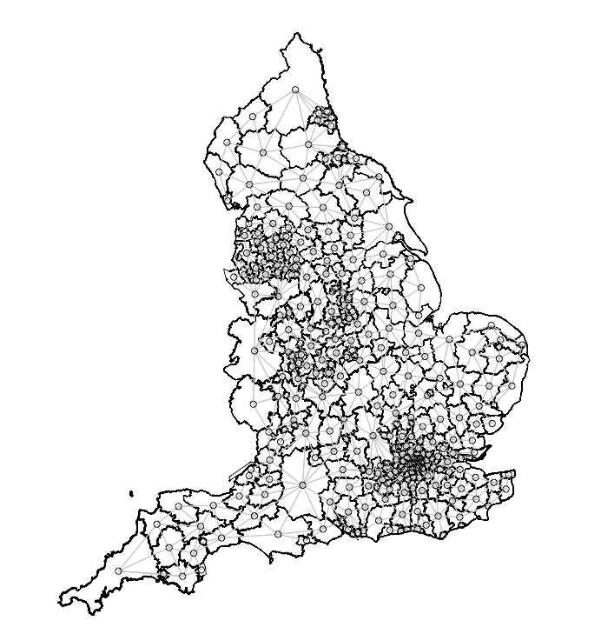
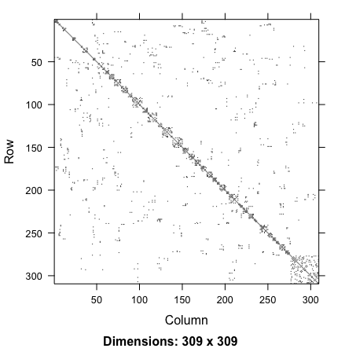
Geographically accurate
neighbourhood structure
Adjacency matrix translated to
graph format
Adjacency matrix translated to
nodes and edge format
Stan only uses the nodes and edges format to reconstruct the adjacency matrix
You need to construct a neighbourhood adjacency matrix to account for the spatial configuration of the study area.
18
Notes:
Explain the matrix and nodes

Slide 19
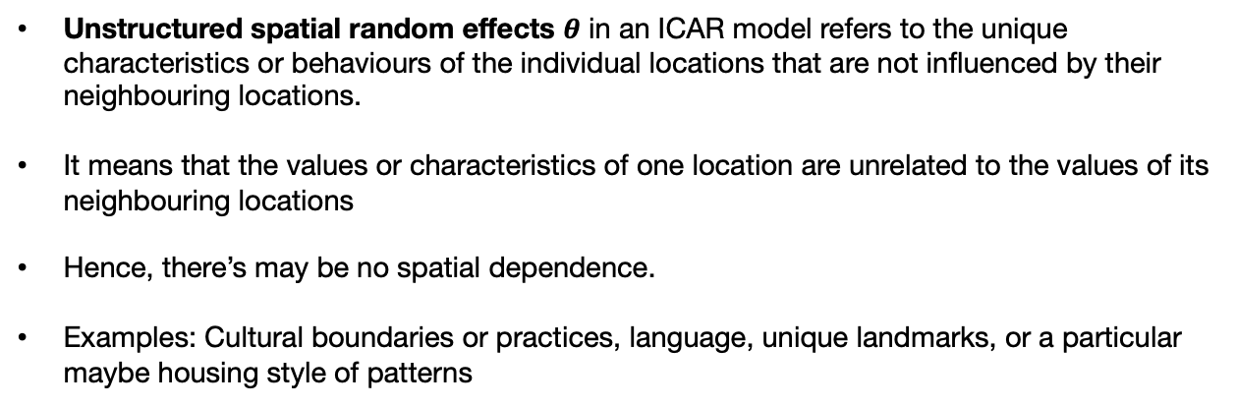
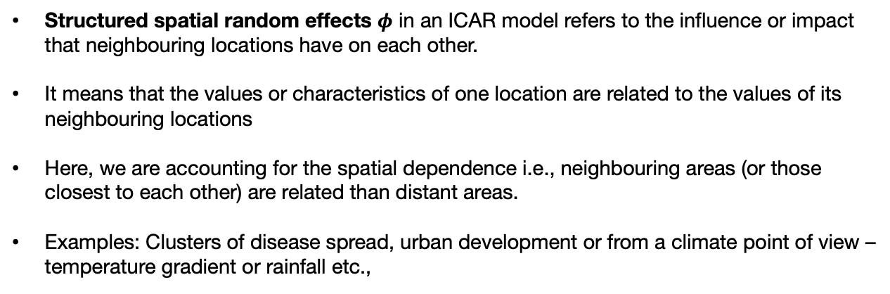
Spatial structured and unstructured random effects [1]
Structured spatial random effects $φ$ in an ICAR model refers to the influence or impact that neighbouring locations have on each other.
It means that the values or characteristics of one location are related to the values of its neighbouring locations
Here, we are accounting for the spatial dependence i.e., neighbouring areas (or those closest to each other) are related than distant areas.
Examples: Clusters of disease spread, urban development or from a climate point of view – temperature gradient or rainfall etc.,
Unstructured spatial random effects $θ$ in an ICAR model refers to the unique characteristics or behaviours of the individual locations that are not influenced by their neighbouring locations.
It means that the values or characteristics of one location are unrelated to the values of its neighbouring locations
Hence, there’s may be no spatial dependence.
Examples: Cultural boundaries or practices, language, unique landmarks, or a particular maybe housing style of patterns
Adjacency matrix translated to nodes and edge format
In an ICAR model, we can account for both these types of random effects by COMBINING them as $φ+θ$
19

Slide 20
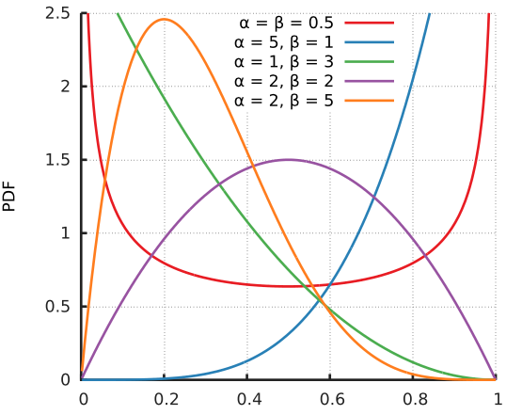

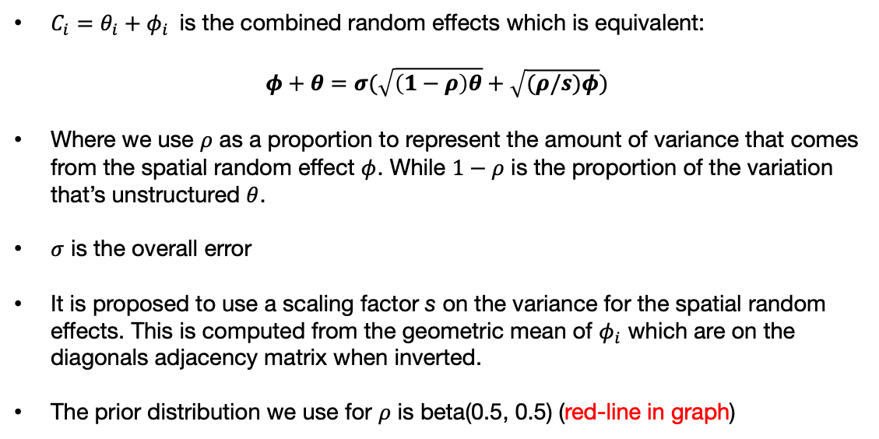
Adding the spatial structured and unstructured effect to the model [2]
$C_{i}=θ_{i}+φ_{i}$ is the combined random effects which is equivalent:
$$φ+θ=σ(\sqrt{\left(1−ρ\right)θ}+\sqrt{(ρ/s)φ})$$
Where we use $ρ$ as a proportion to represent the amount of variance that comes from the spatial random effect $φ$. While $1−ρ$ is the proportion of the variation that’s unstructured $θ$.
$σ$ is the overall error
It is proposed to use a scaling factor s on the variance for the spatial random effects. This is computed from the geometric mean of $φ_{i}$ which are on the diagonals adjacency matrix when inverted.
The prior distribution we use for $ρ$ is beta(0.5, 0.5) (red-line in graph)
Adjacency matrix translated to nodes and edge format
Node1 is the index area of interest;
Node2 is the neighbouring areas connected to the index area defined in Node1.
N is the total number of areas.
target += -0.5*dot_self(phi[node1] – phi[node2])
sum(phi) ~ normal(0, 0.001*N)
$$ρ$$
20

Slide 21
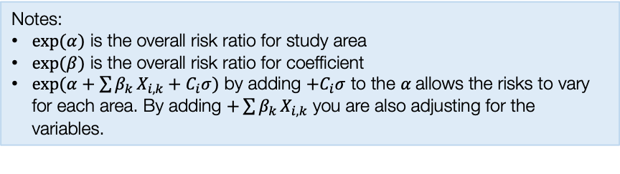
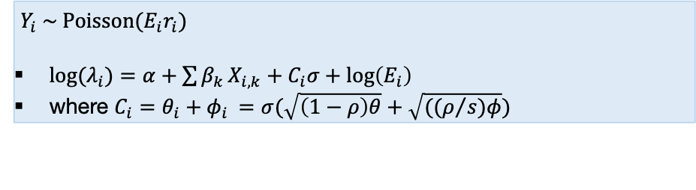
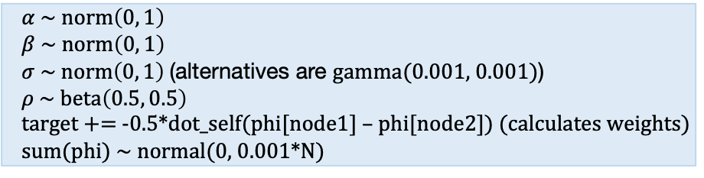
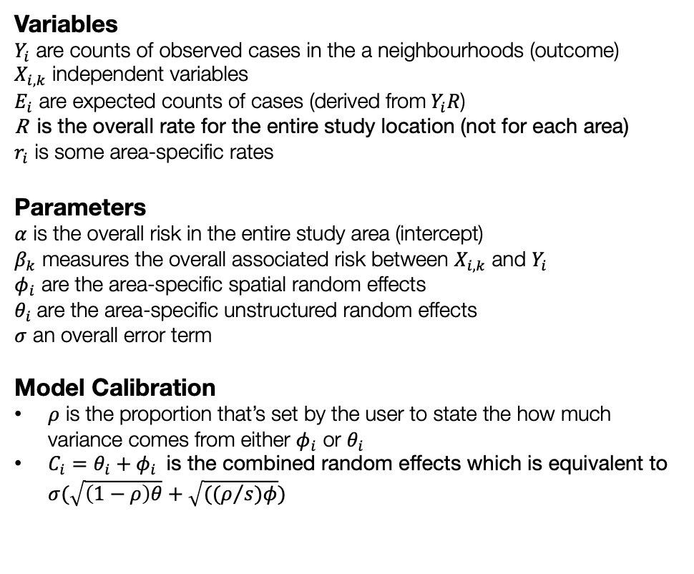
Model formulation for Spatial ICAR model
Model components
Full model specification
Variables
$Y_{i}$ are counts of observed cases in the a neighbourhoods (outcome)
$X_{i,k}$ independent variables
$E_{i}$ are expected counts of cases (derived from$Y_{i}R$)
R is the overall rate for the entire study location (not for each area)
$r_{i}$ is some area-specific rates
Parameters
$α$ is the overall risk in the entire study area (intercept)
$β_{k}$ measures the overall associated risk between $X_{i,k}$ and $Y_{i}$
$φ_{i}$ are the area-specific spatial random effects
$θ_{i}$ are the area-specific unstructured random effects
$σ$ an overall error term
Model Calibration
$ρ$ is the proportion that’s set by the user to state the how much variance comes from either $φ_{i}$ or $θ_{i}$
$C_{i}=θ_{i}+φ_{i}$ is the combined random effects which is equivalent to $σ(\sqrt{\left(1−ρ\right)θ}+\sqrt{((ρ/s)φ})$
Specify likelihood function. The outcome is often counts – thus it will be Poisson (with log as the link function).
$Y_{i} \sim Poisson(E_{i}r_{i})$
${log⁡(λ}_{i})=α+\sum{β_{k}}X_{i,k}+C_{i}σ+log\left(E_{i}\right)$
where $C_{i}=θ_{i}+φ_{i}$ $=σ(\sqrt{\left(1−ρ\right)θ}+\sqrt{((ρ/s)φ})$
Define the priors for the intercept, coefficients and spatial and unstructured random effects as with an ICAR specification
$α \sim norm\left(0, 1\right)$
$β \sim norm\left(0, 1\right)$
$σ \sim norm\left(0, 1\right)$ (alternatives are gamma(0.001, 0.001))
$ρ \sim beta\left(0.5, 0.5\right)$
target += -0.5*dot_self(phi[node1] – phi[node2]) (calculates weights)
sum(phi) ~ normal(0, 0.001*N)
Build Bayesian model
Recall the Bayes’ Rule: $P\left(θ | Y\right)∝P\left(Y | θ\right)P(θ)$
Notes:
$exp⁡(α)$ is the overall risk ratio for study area
$exp⁡(β)$ is the overall risk ratio for coefficient
$exp(α+\sum{β_{k}}X_{i,k}+C_{i}σ)$ by adding ${+C}_{i}σ$ to the $α$allows the risks to vary for each area. By adding $+\sum{β_{k}}X_{i,k}$ you are also adjusting for the variables.
$$P\left(α, β_{k}, σ, φ_{i} | { λ}_{i}\right)∝P\left({ λ}_{i} | α, β_{k}, σ, φ_{i}\right) P\left(α\right)P\left(β_{k}\right)P\left(σ\right)P(φ_{i})P\left(ρ\right)$$
21

Slide 22
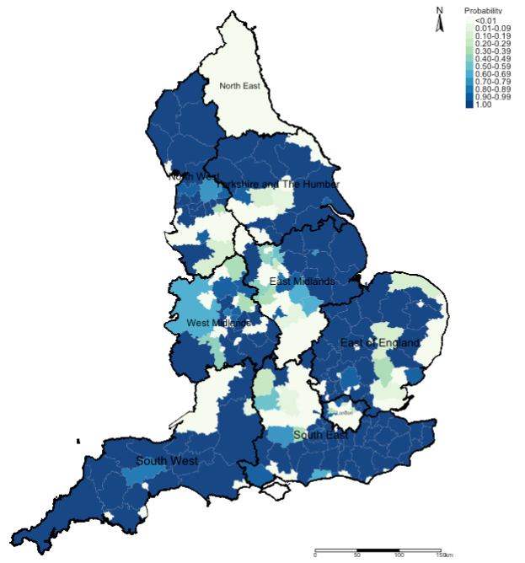
Relative risk ratios (RR)
Statistical Significance
Exceedance Probabilities
Here, we use this output to describe the burden of an outcome
This output is to valid whatever hypothesis we had about the described outcome’s burden in the first map
This output is used to describe the uncertainty that surrounds the risks we found in the first map when we explore P(RR>1)
22

Slide 23
Relative risk ratios (RR)
Statistical Significance
Exceedance Probabilities
Interpretation: We can see that the risk patterns for road accidents across England are quite heterogeneous. While it is quite pronounced in all 10 regions in England, the burden is quite significant in South West region with large numbers of local authorities having an increased risk which are statistically significant. Perhaps, the Department for Transport should do an investigation on these patterns starting with the South West area.
23

Slide 24
Application: Risk assessment and mapping of infestation in Campina Grande
24

Slide 25
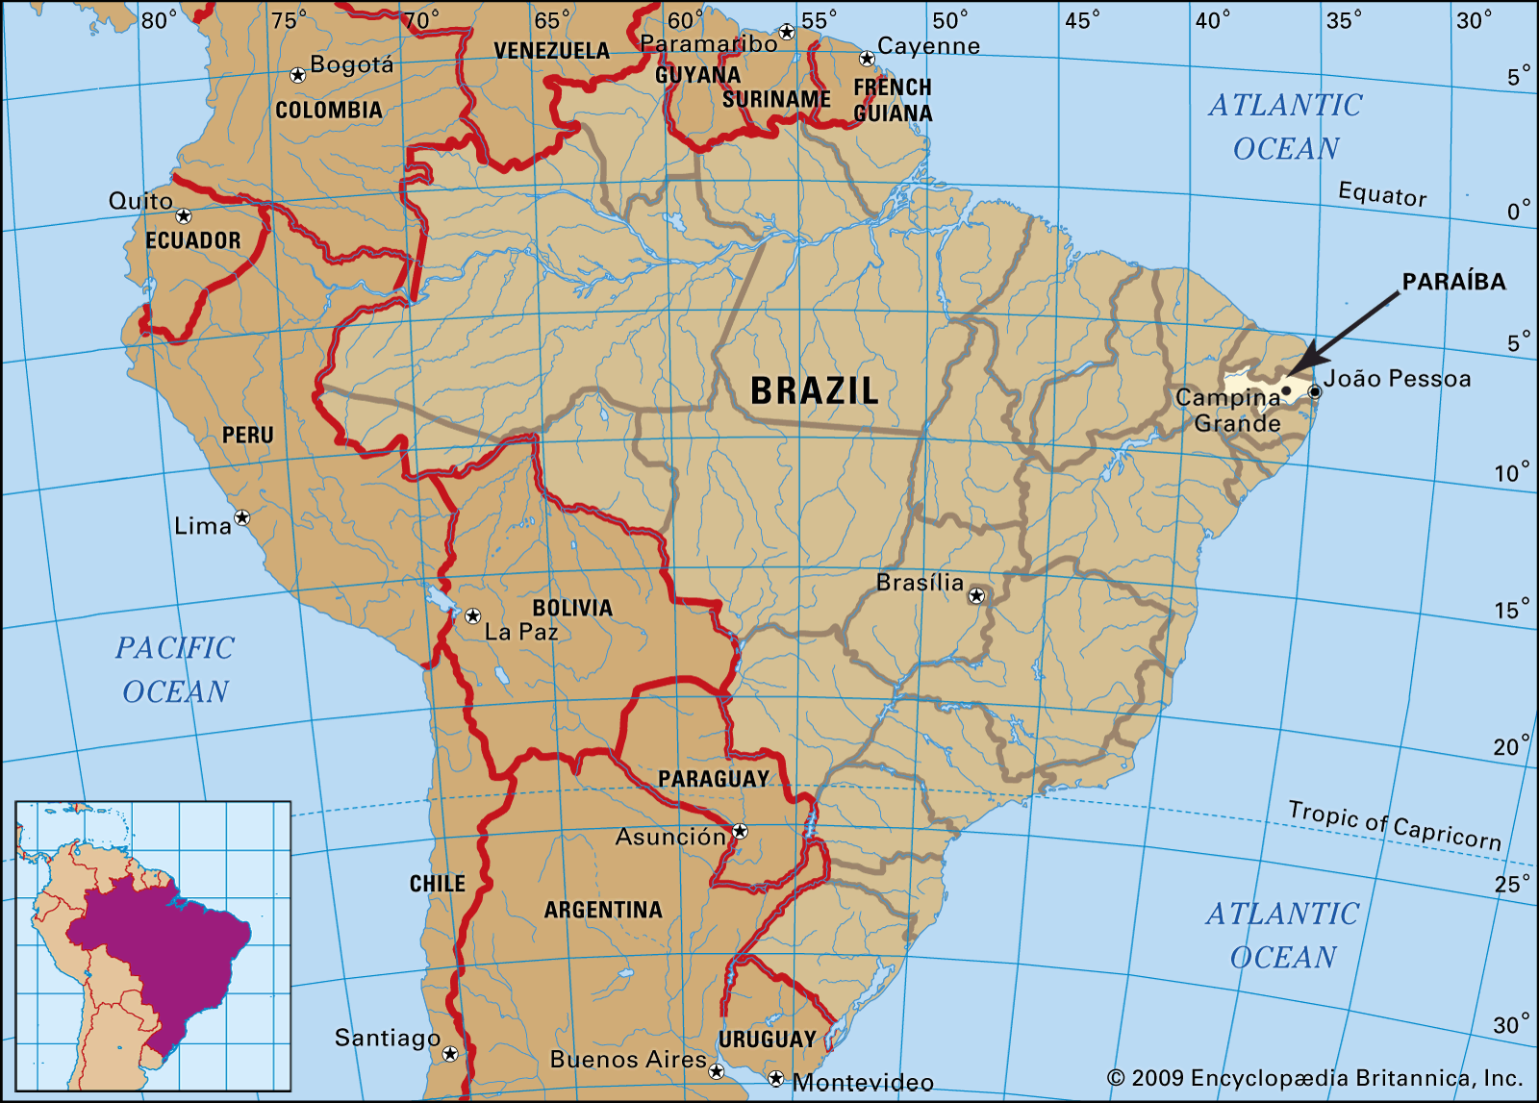
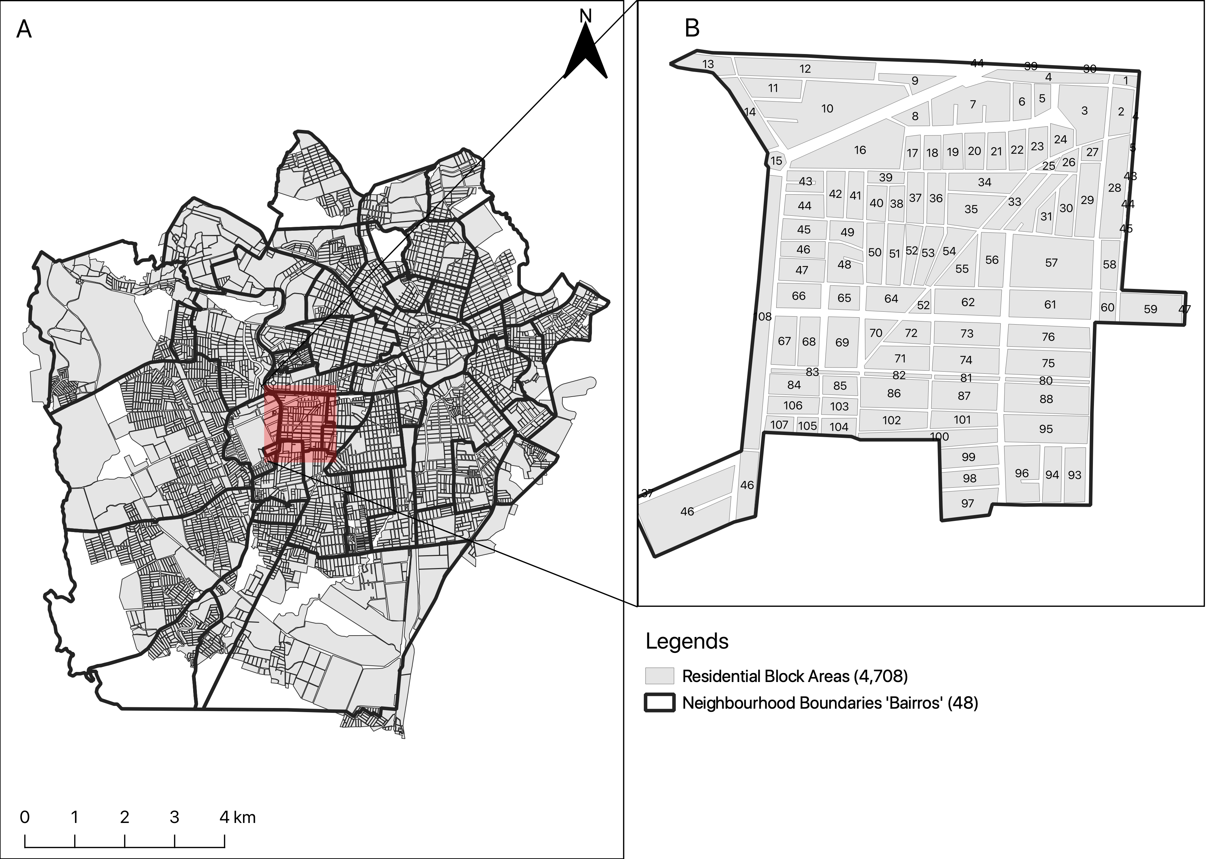
Campina Grande is into 47 neighbourhoods
Most recent vector control data (Levantamento Rapid de Indice para Aedes a [LIRAa]): January 2013 to October 2017 (performed 3–5 times in a year)
Baseline information – the overall number of houses in neighbourhood (as denominators); total number of households detected to be infested with larvae or adult mosquito (i.e., Aedes aegypti)
Aims and objectives:
To quantify the risk trajectories of mosquito infestation on a neighbourhood-level to informs the profile of the neighbourhood (i.e., whether the risks were sustained across the LIRAa periods).
Determining the set of environmental, climate and anthropogenic risk factors that impact neighbourhood-levels of Aedes aegypti infestation in households.
25
Notes:
Portuguese: Levantamento Rapido de Indice para Aedes aegypti (Rapid Index Survey for Aedes aegypti)
The goal is to harness this rich resource in order to…

Slide 26
Research Methodology & Study design
 | Survey Periods
LIRAa | 2013 | 2014 | 2015 | 2016 | 2017
1 | January | January | January | April | January
2 | March | March | March | July | April
3 | May | May | May | October | July
4 | July | July | October
5 | October | October
Methodology:
Population-based ecological study design within repeated cross-sectional (and retrospective) framework
For covariates, the analysis included:
WorldClim (4.5km) (Maximum temperature and Precipitation) (monthly)
MOD18A1.061 Terra Vegetation Indices 16-Day Global 500m to compute neighbourhood levels of vegetation based on the NDVI metrics (monthly)
Worldpop.org (100m) to extract rasters for urbanisation (which contains binary grids) to compute the fraction of surface that is urbanised for neighbourhoods (yearly).
Spatial risk model with Intrinsic Conditional Autoregressive (ICAR) Model; and applied Bayesian updating to derive new global coefficients for covariates for each LIRA survey, as well as neighbourhood-specific relative risk estimates.
26
Notes:
In terms of methodology, we utilised

Slide 27
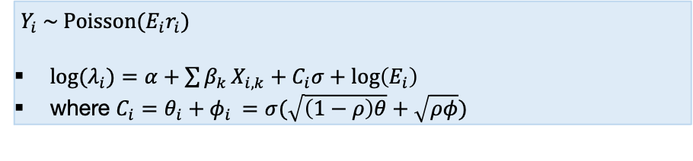
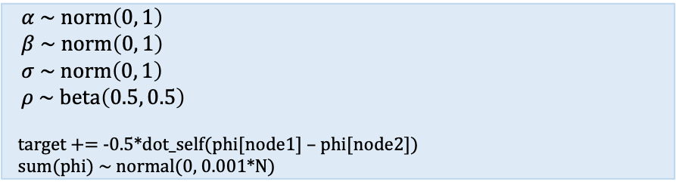
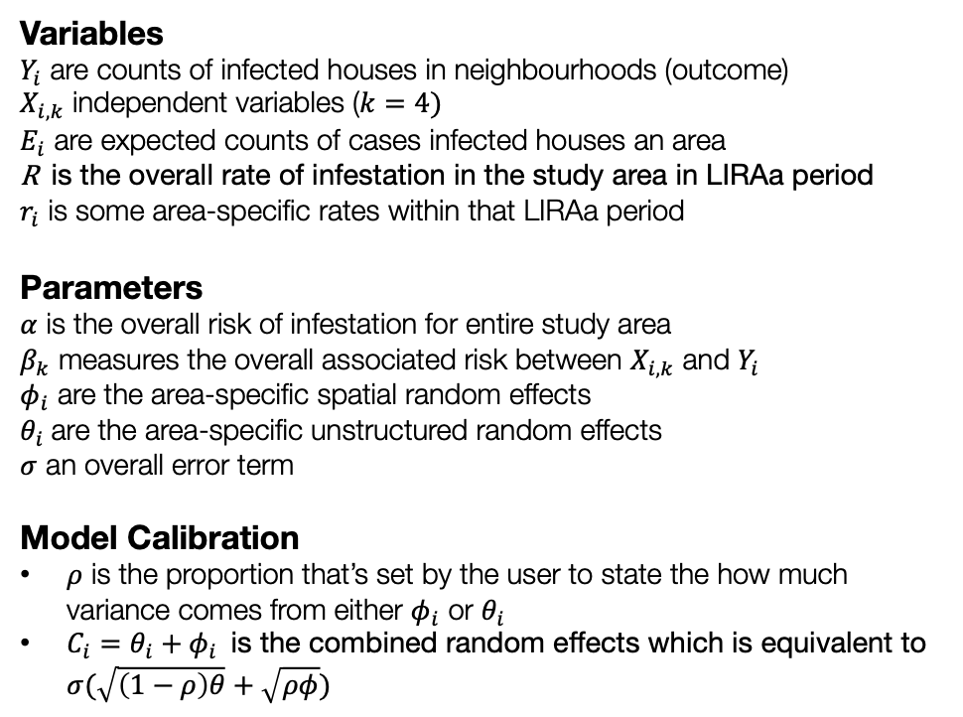
Model formulation for Spatial ICAR model
Model components
Full model specification
Variables
$Y_{i}$ are counts of infected houses in neighbourhoods (outcome)
$X_{i,k}$ independent variables ($k=4)$
$E_{i}$ are expected counts of cases infected houses an area
R is the overall rate of infestation in the study area in LIRAa period
$r_{i}$ is some area-specific rates within that LIRAa period
Parameters
$α$ is the overall risk of infestation for entire study area
$β_{k}$ measures the overall associated risk between $X_{i,k}$ and $Y_{i}$
$φ_{i}$ are the area-specific spatial random effects
$θ_{i}$ are the area-specific unstructured random effects
$σ$ an overall error term
Model Calibration
$ρ$ is the proportion that’s set by the user to state the how much variance comes from either $φ_{i}$ or $θ_{i}$
$C_{i}=θ_{i}+φ_{i}$ is the combined random effects which is equivalent to $σ(\sqrt{\left(1−ρ\right)θ}+\sqrt{ρφ})$
Specify likelihood function. The outcome is often counts – thus it will be Poisson (with log as the link function).
$Y_{i} \sim Poisson(E_{i}r_{i})$
${log⁡(λ}_{i})=α+\sum{β_{k}}X_{i,k}+C_{i}σ+log\left(E_{i}\right)$
where $C_{i}=θ_{i}+φ_{i}$ $=σ(\sqrt{\left(1−ρ\right)θ}+\sqrt{ρφ})$
Define the priors for the intercept, coefficients and spatial random effects as with an ICAR specification
$α \sim norm\left(0, 1\right)$
$β \sim norm\left(0, 1\right)$
$σ \sim norm\left(0, 1\right)$
$ρ \sim beta\left(0.5, 0.5\right)$
target += -0.5*dot_self(phi[node1] – phi[node2])
sum(phi) ~ normal(0, 0.001*N)
Build Bayesian model
Recall the Bayes’ Rule: $P\left(θ | Y\right)∝P\left(Y | θ\right)P(θ)$
Notes:
$exp⁡(α)$ is the overall risk ratio for study area
$exp⁡(β)$ is the overall risk ratio for coefficient
$exp(α+\sum{β_{k}}X_{i,k}+C_{i}σ)$ by adding ${+C}_{i}σ$ to the $α$allows the risks to vary for each area. By adding $+\sum{β_{k}}X_{i,k}$ you are also adjusting for the variables.
$$P\left(α, β_{k}, σ, φ_{i} | { λ}_{i}\right)∝P\left({ λ}_{i} | α, β_{k}, σ, φ_{i}\right) P\left(α\right)P\left(β_{k}\right)P\left(σ\right)P(φ_{i})P\left(ρ\right)$$
New models with LIRAa data that follows are updated, this know as Bayesian updating.
27

Slide 28
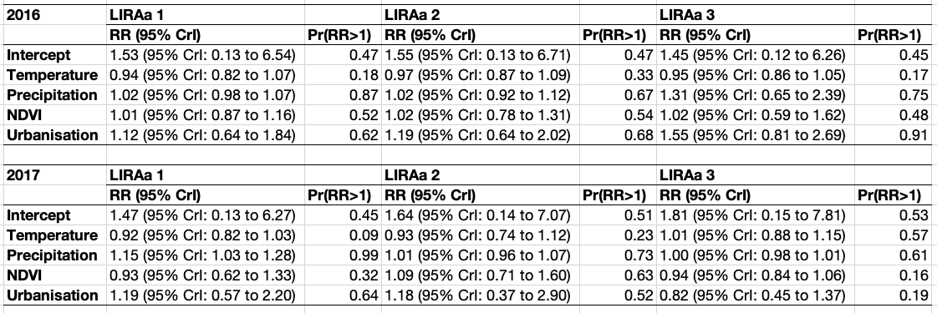
Table results illustrates the overall association between environmental, climate and anthropogenic factors and risk of infestation in Campina Grande.
RR: Relative risks
Pr(RR > 1): Exceedance probabilities (the probability that RR being greater than 1)
Preliminary result
28

Slide 29
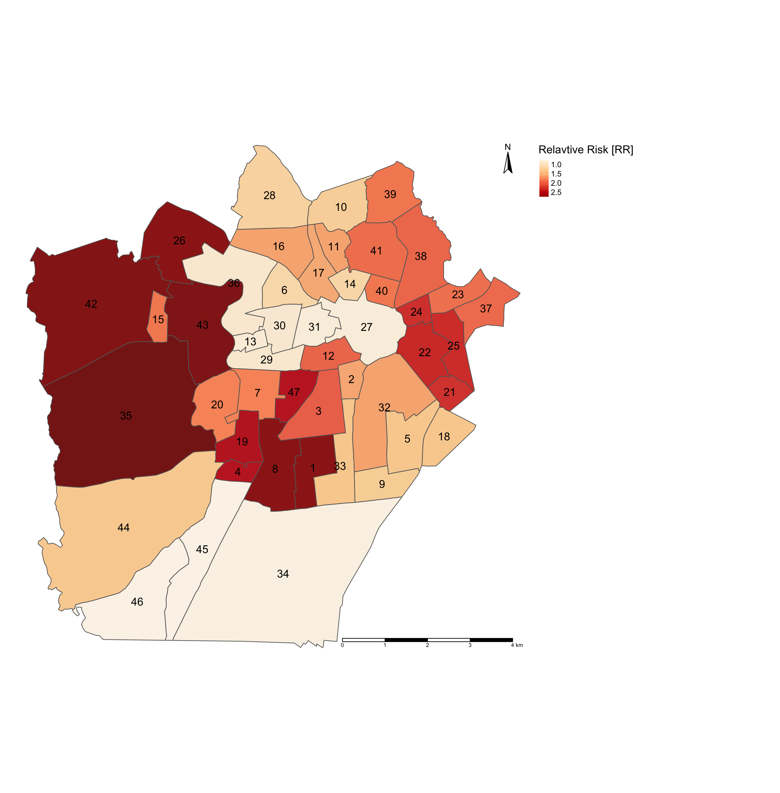
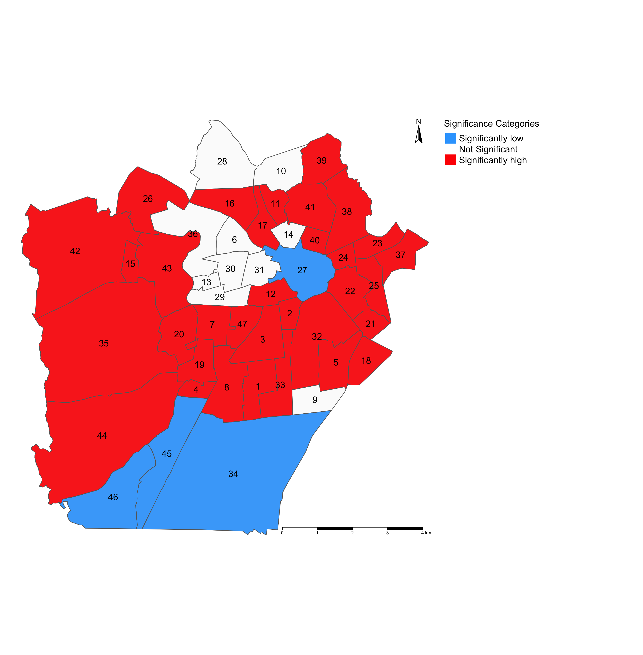
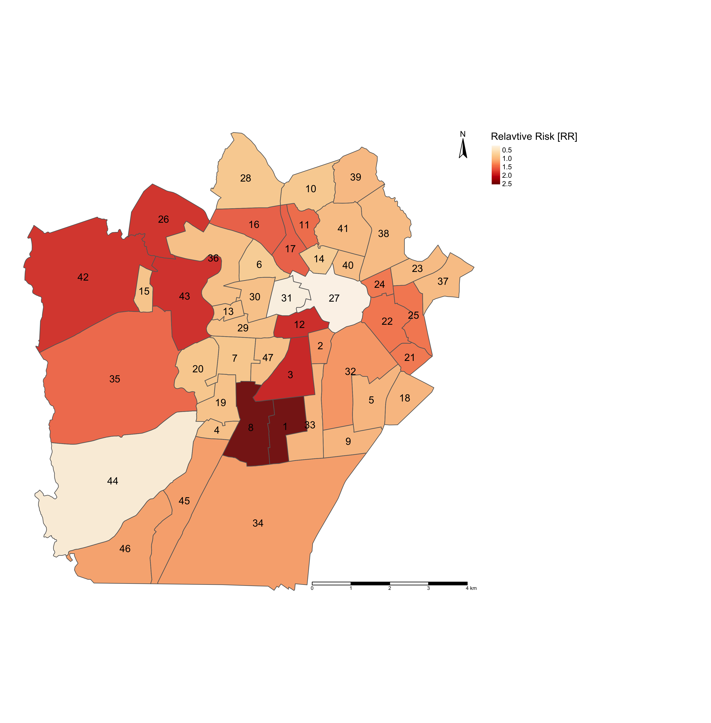
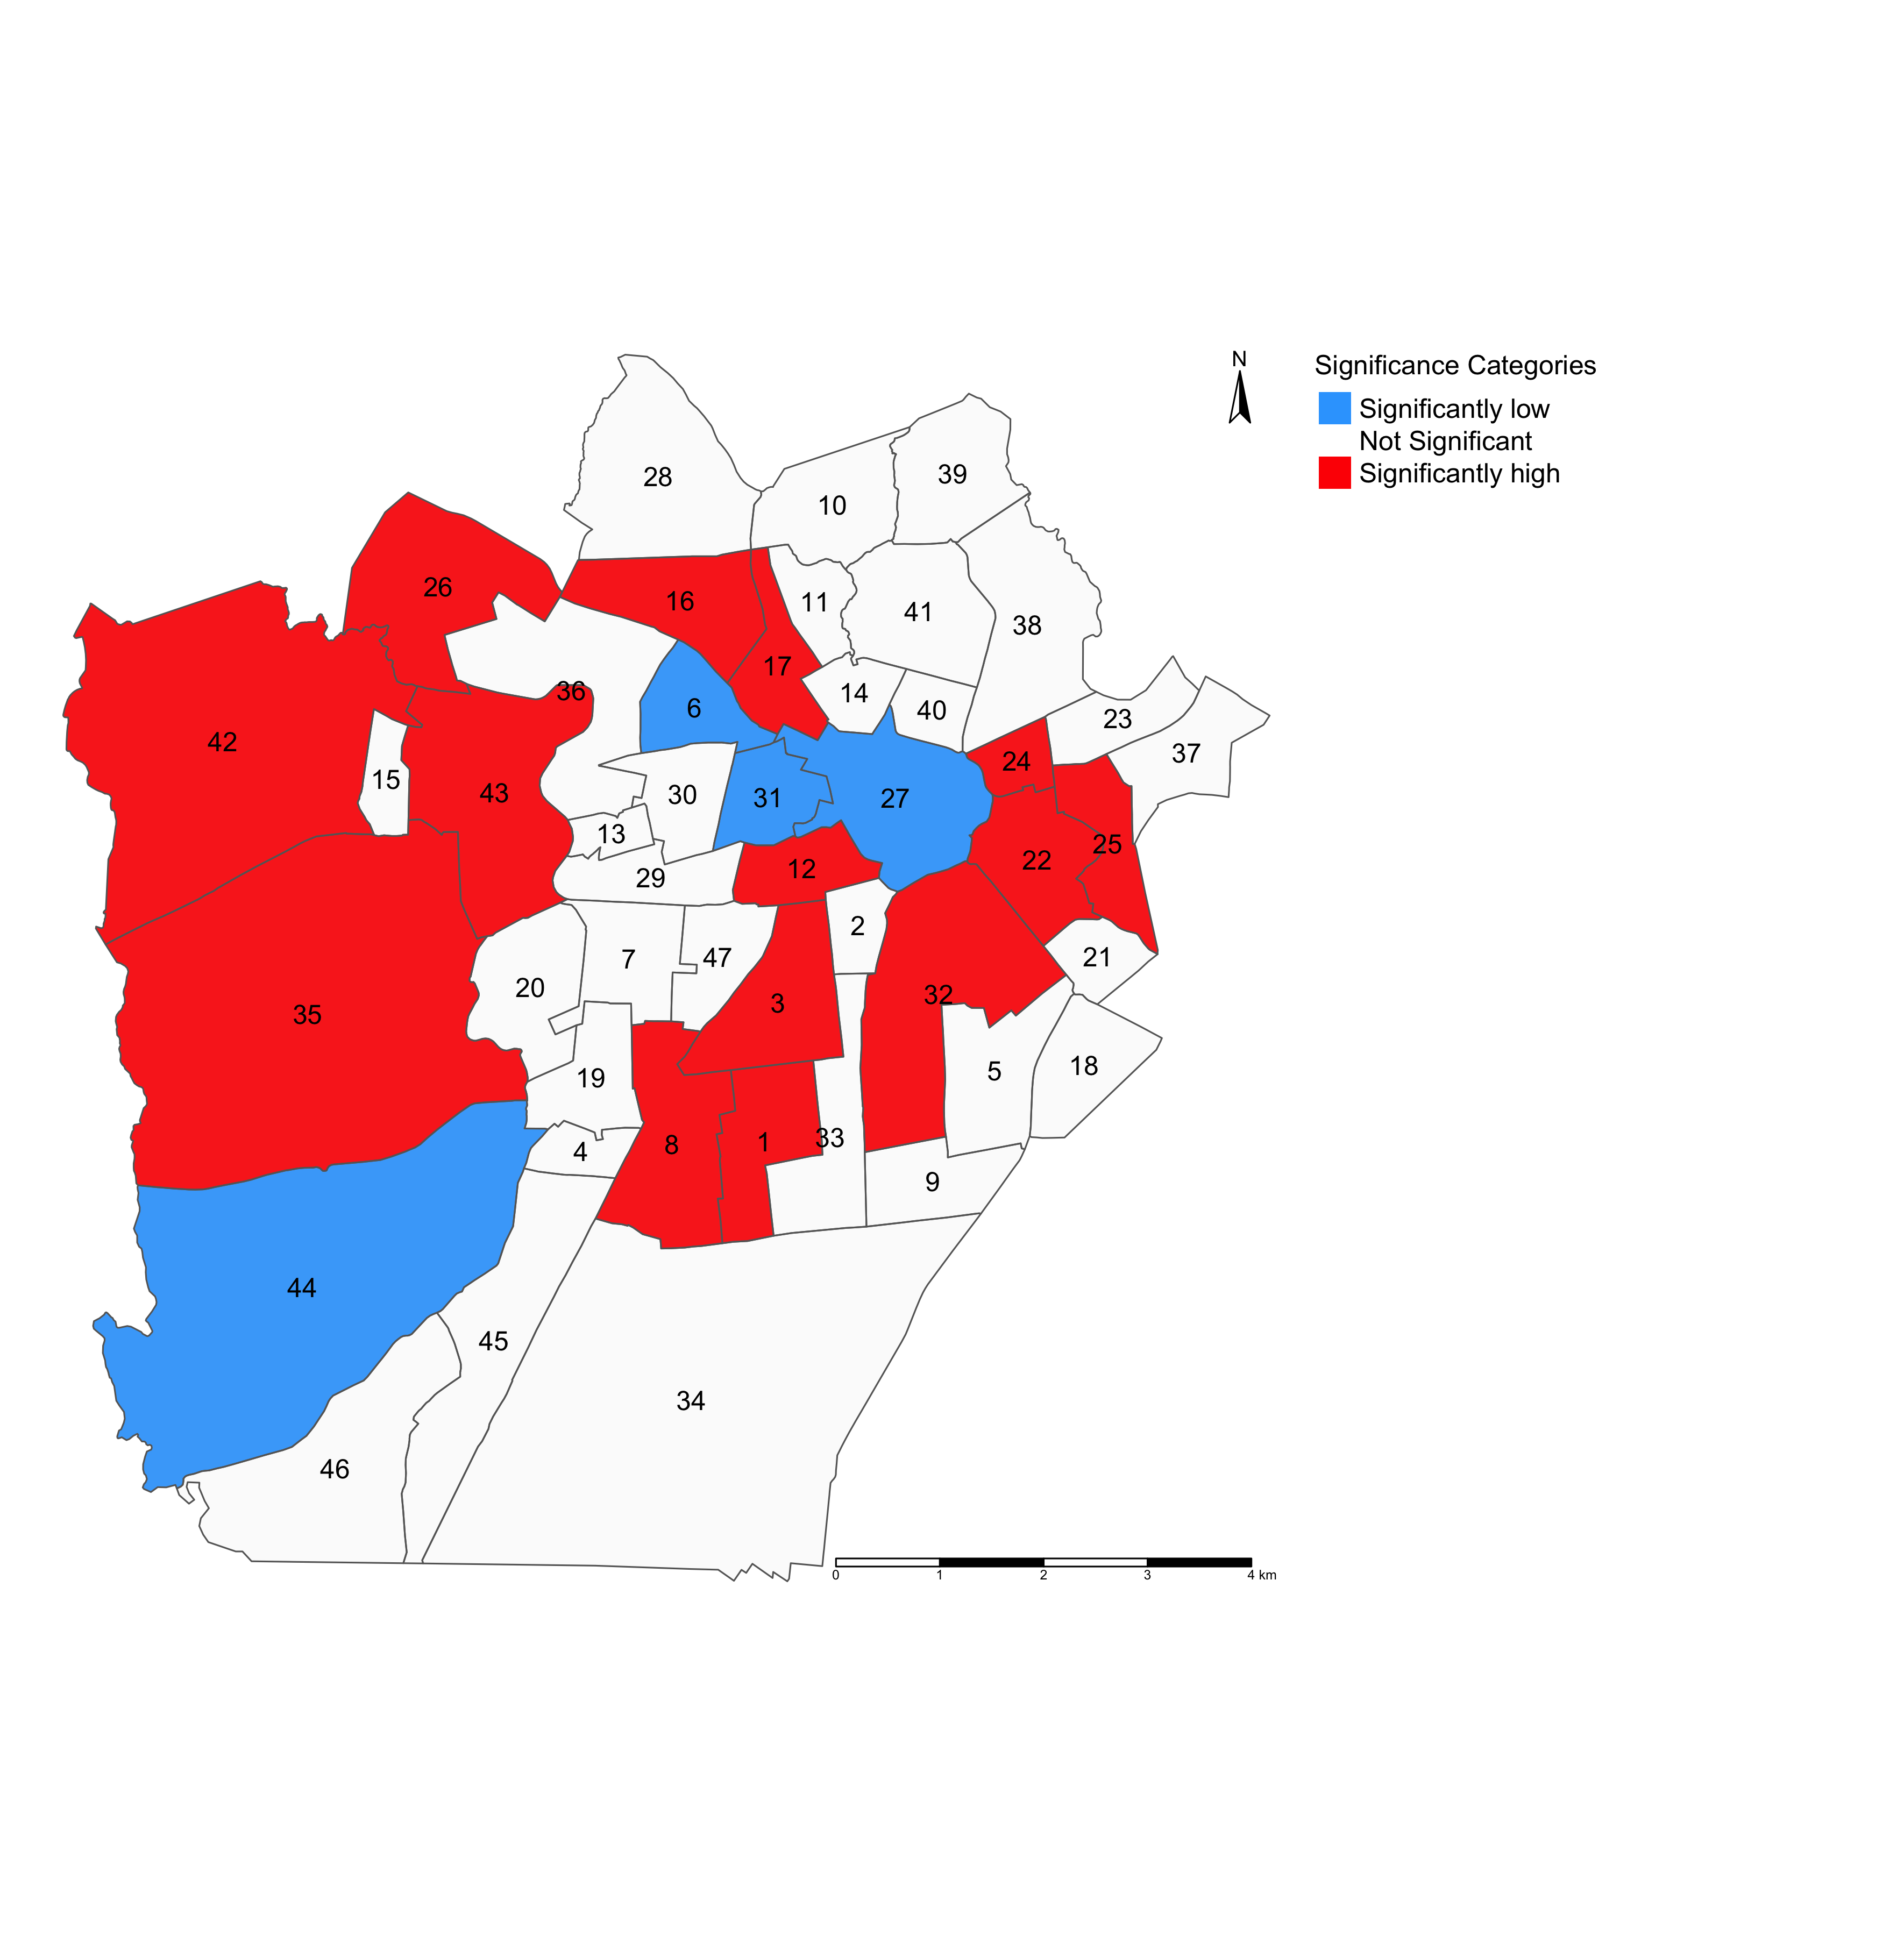
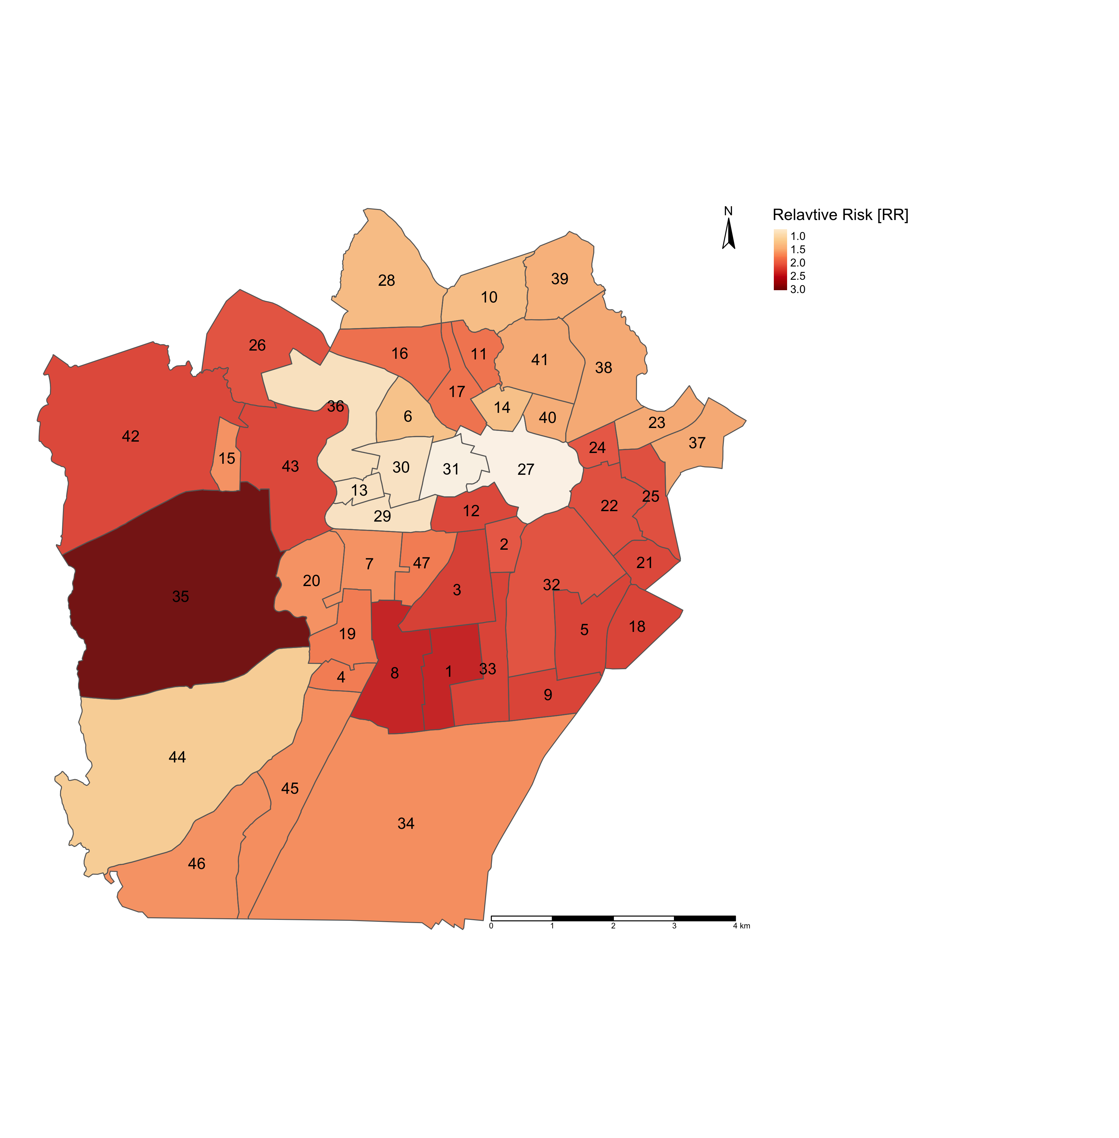
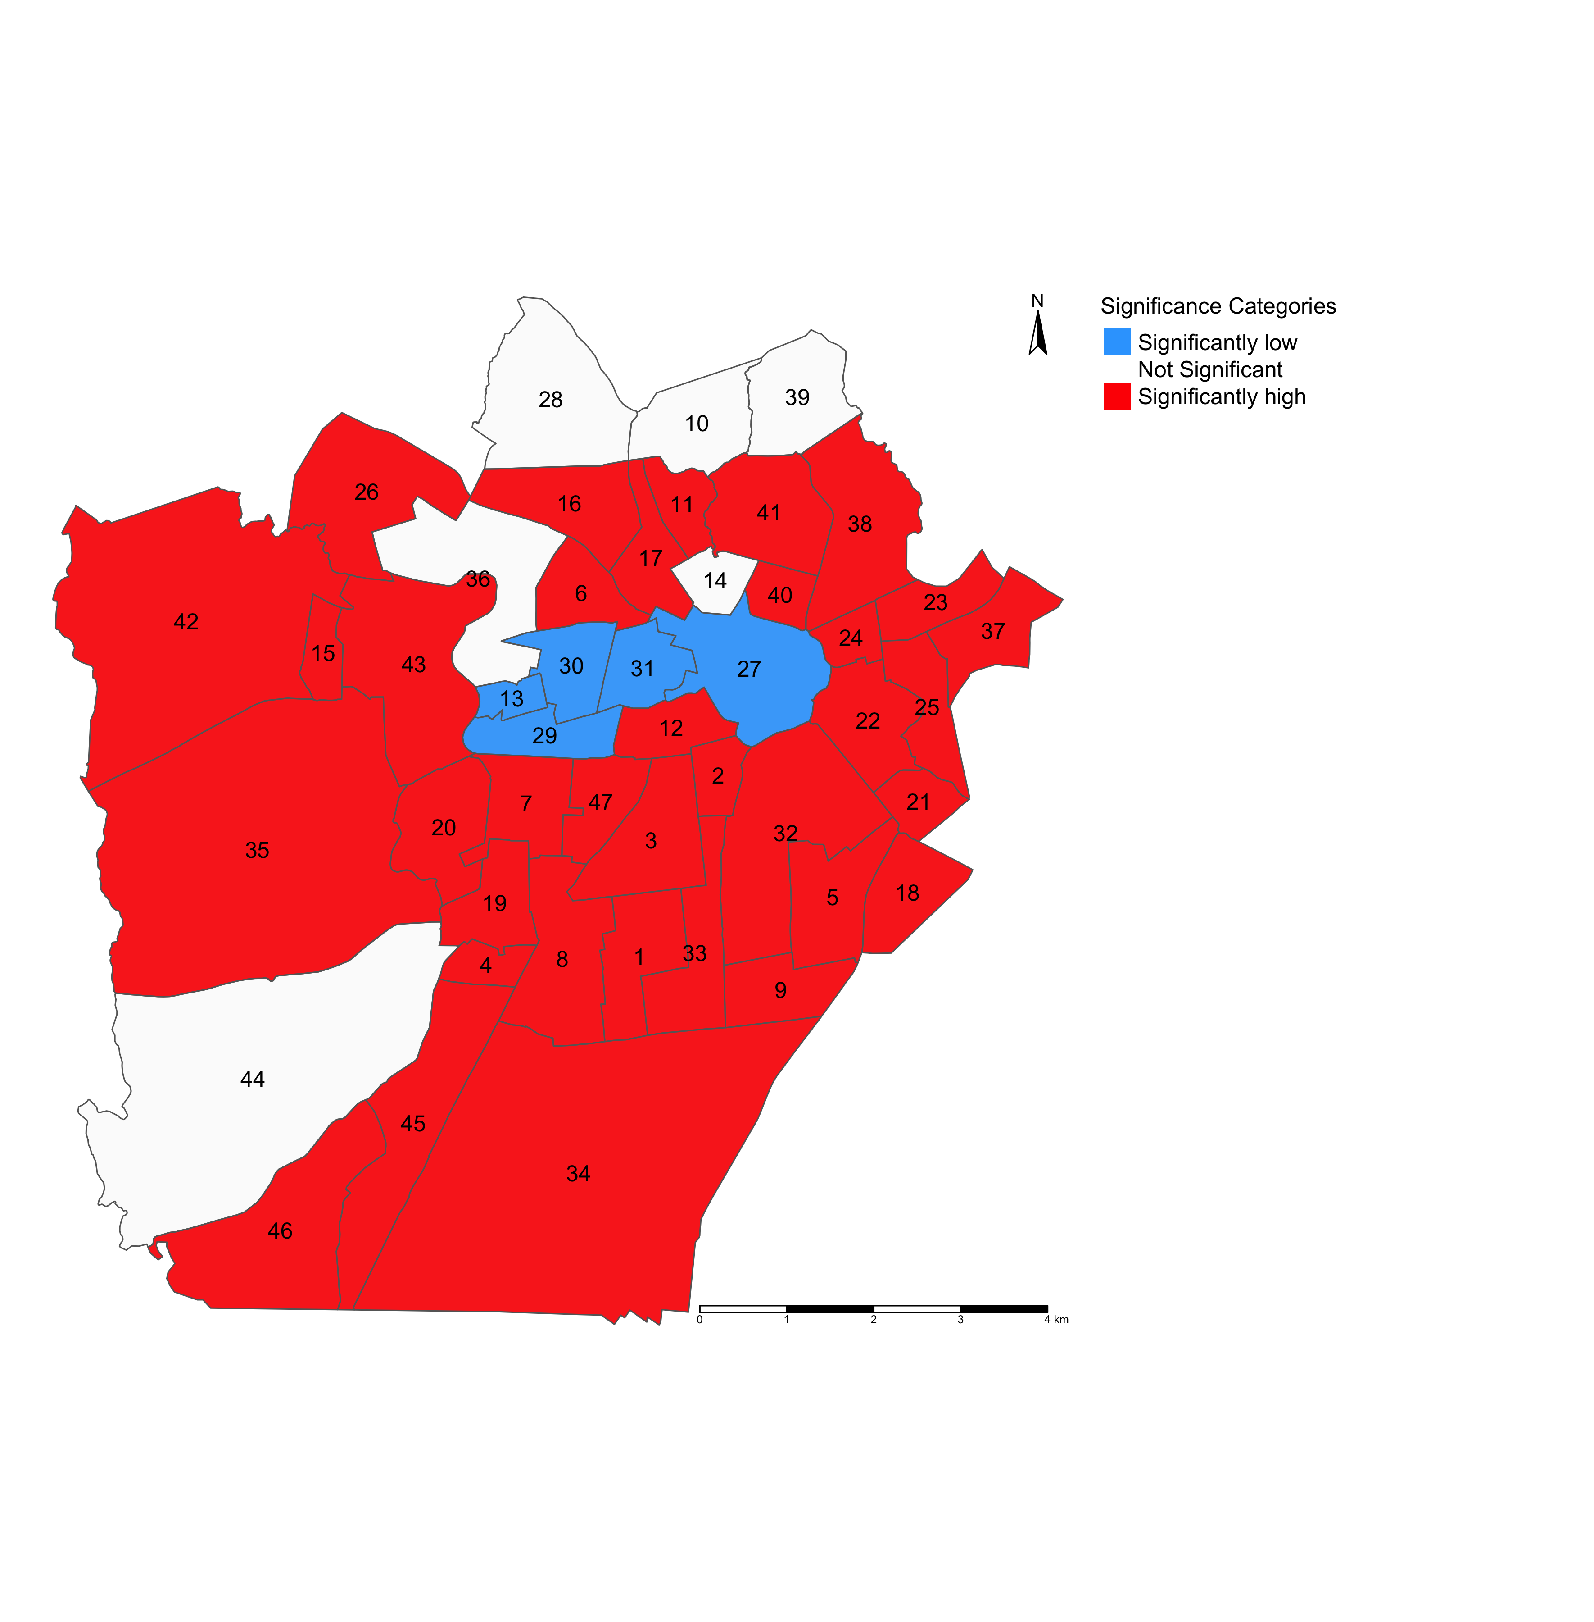

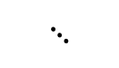



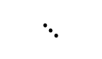
Maps on the left panel illustrates the relative risk (RR) of infestation across neighbourhoods in Campina Grande
Maps on the right panel illustrates which neighbourhoods in Campina Grande have RRs that are significantly “low” or “high” risk
$$⋱$$
$$⋱$$
$$⋱$$
$$⋱$$
LIRAa 1 2017
LIRAa 1 2017
LIRAa 2 2017
LIRAa 2 2017
LIRAa 3 2017
LIRAa 3 2017
$$⋱$$
$$⋱$$
RR < 1.00 (Low risk)
RR > 1.00 (High risk)
RR = 1.00 (Non-significant risk)
Preliminary result
29

Slide 30
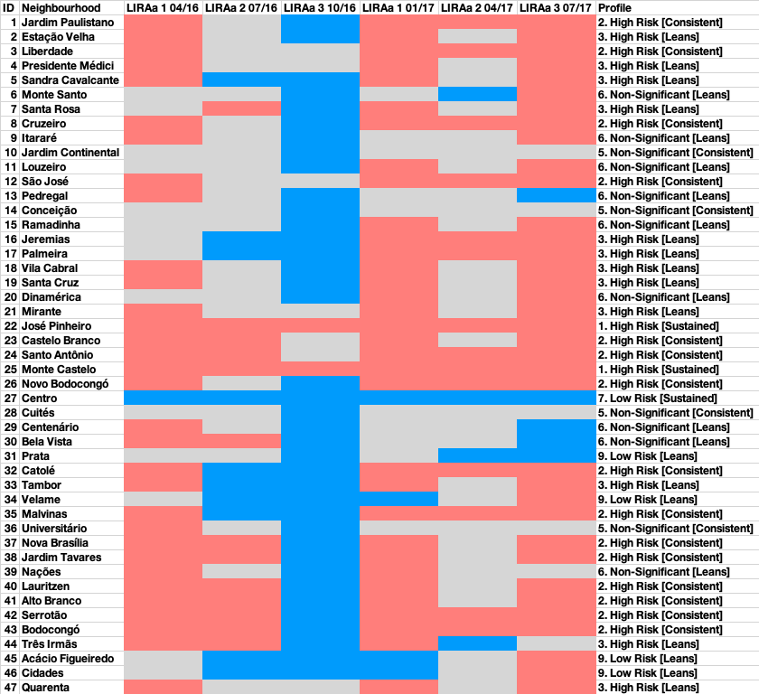
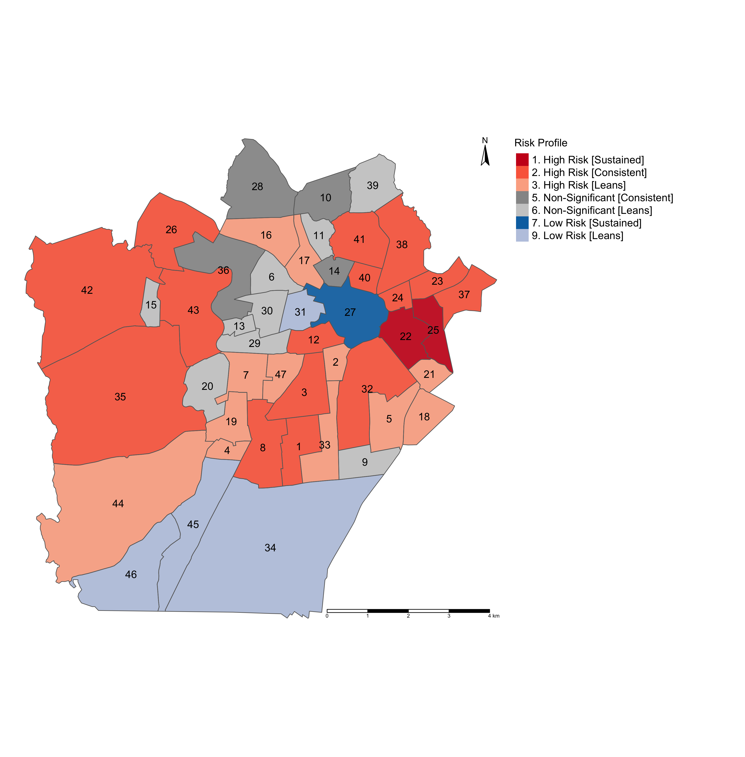
Modelling the risk trajectories and charting them across these LIRAa periods
Profiling the neighbourhoods accordingly to examine where these significant risks of infestation are sustained
Preliminary result
30

Slide 31

Any questions?
31

